Slide 1
My Time in the Clink
Pondering the meaning of it all, some random musings by someone in lock down to the dreaded fizzy-pop…

Slide 2
WHY are we here?
Not in the existentialist sense of this question (we’re here to help others, although what the others are here for is uncertain). Some are blaming the Chinese, but the existence of a maleficent super-being, bent on worldwide destruction is for Marvel comics. Nobody wanted this, don’t blame anybody. It may also be tempting to blame the government, a frequently popular standpoint, but try to remember that they told us from the start that there would be four phases, so Government response was always going to evolve…

Slide 3
WHAT is the risk?
If you're "older" (than what?) or have underlying health issues (show me someone over 50 who doesn't) you should consider self-isolation or anti-social distancing. A lot of us fall into this category, and it brings with it another suite of dilemmas…
First you need to decide if you're isolating together with your loved ones or setting up an apartheid regime indoors…

Slide 4
Quarantine Issues:
Living separately can have its problems. To try to communicate but keep an element of levity, John and I are using walkie-talkies to chat between rooms…
The benefits of apartheid are that you can nominate the fittest or least popular member of the household to venture out to fetch food or prescriptions.
The downside is that to do it properly you will have to divvy up the rooms, household appliances and stake a personal claim to door handles and light switches. In the Ragan household, I get the kitchen, John gets the TV remote control, and I’ve tied pink ribbons on ‘my’ door handles, blue ribbons on John’s door handles (we are very traditional in our gender choices, this is not the time for non-binary quandaries).

Slide 5
WHEN can I leave the house?
You can leave the house to go for a walk, according to government advice, but you need to stay two metres apart. The radio advises that if you can touch someone with a broom, you're too close. Or as Tony Hancock would say, “stop poking me with that stick!”
CLICK HERE

Slide 6
Venturing Out:
Also, if the person walking behind is catching you up, you will need to quicken your pace to maintain the required anti- social distance, which could result in a Benny Hill-type chase (a little music to reminisce to)
CLICK HERE

Slide 7
What about shortages?
If you are the nominated shopper and you find the supermarket shelves are bare, remember you have other options. You could raid the pantry and get creative with all the pot noodles, exotic spices and marzipan (ignore the best before date, normal rules don't apply) Here are some tips:
CLICK HERE
But food may not be the problem…
Revive the wartime approach to shortages of toilet rolls by repurposing your daily newspaper. I would recommend trying to wear the ink off before re-use, or the story will stay with you*.

Slide 8
HOW should I occupy myself at home?
Try learning a new skill. Maybe study a foreign language (if we are ever allowed to use our passports again, think how useful it would be to be able to order a beer without resort to shouting or miming)….
CLICK HERE
Or learn to open doors with your elbows. This will be useful in the shorter term, when you arrive at a door with the wrong colour ribbon.
If you have entrepreneurial tendencies and some cash in the bank, you could consider buying shares. Amazon; all phone and broadband companies; and manufacturers of soap, hand cream, disposable gloves and anti-virus wipes are all on the up.
Then again, I’m working from home every morning. While I’m glad to have some structure to my day, achieving work-life separation can be tricky …
CLICK HERE

Slide 9
Keeping active and eating healthily:
12 weeks alone with a stocked kitchen and little to do… hmm, I’ll have to be careful.

Slide 10
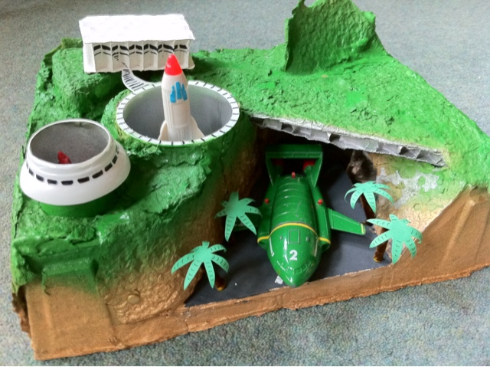
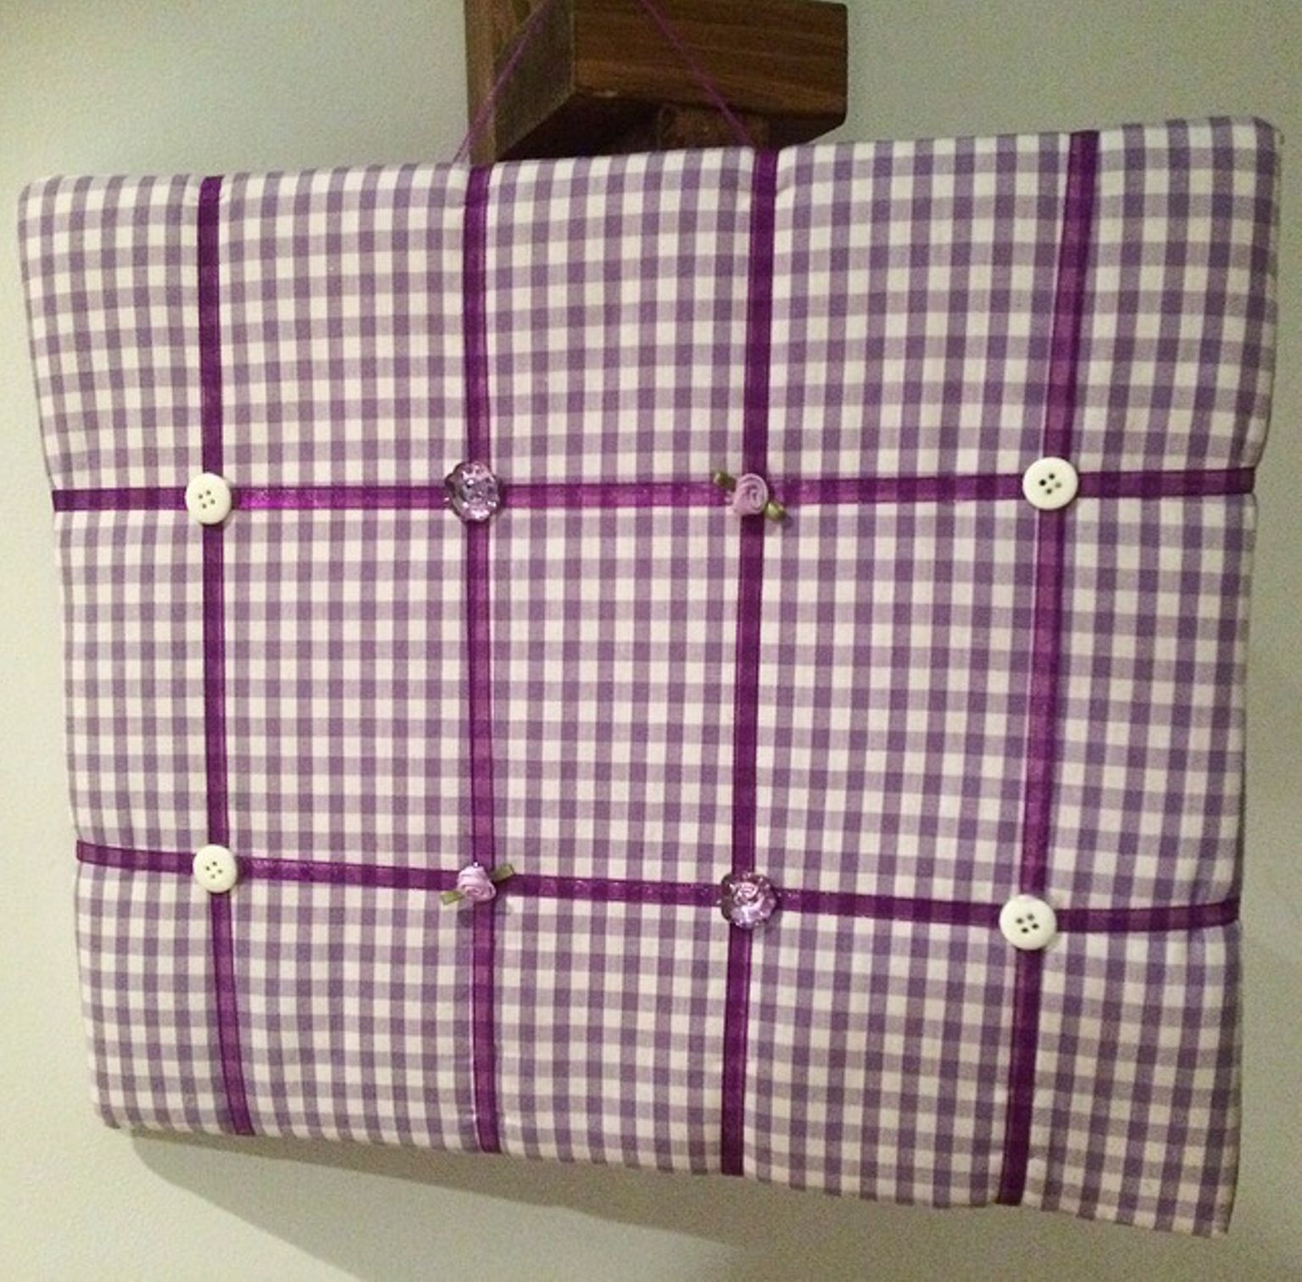
What if services are cut further?
We may need to manage our own rubbish disposal if services are cut back. I’m going to hold onto toilet roll middles, match boxes, washing up bottles... Then hold a household challenge to recreate favourite blue Peter models.
If you can't get out to buy the occasional gift item, repurpose household finds. I fashioned a handy pinboard from my husband's favourite shirt and stuffed it with cat hair. He has a terrible memory so I'm confident the apartheid will outlast his resentment.

Slide 11
Evenings dragging?
I mentioned I may try out new and fetching hairstyles, but did you know you can do this to someone else? Get a photo of your loved one and spend an evening online
CLICK HERE

Slide 12
More fireside fun
We’ve decided to go ‘old school’ and get the board games out, but playing them at anti-social distance using a broom handle to move the counters. Once we’re using squares of newspaper in the loo*, we’ll have the chance to liven things up with a lamplight game of ‘what’s that headline’

Slide 13
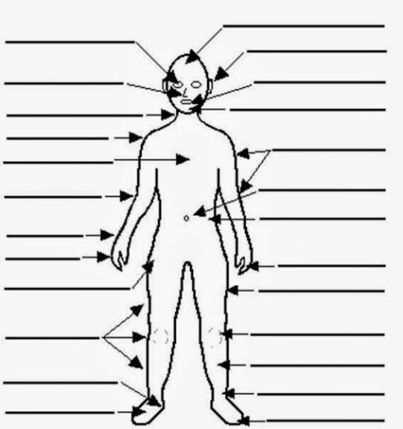
Worst case scenario…
If this is too morbid for you, why not make up nicknames for, or write an ode to your favourite body part?
Planning for a worst case scenario, I will update my will. In order to leave a lasting impression, I’m also going to try to decide in advance what my last words will be. One of my favourites is what Buddy Rich (drummer) said, when asked before his final operation ‘is there anything [meaning medication] you can’t take? He replied, ‘yeah, country music’.

Slide 14
Final thoughts
So, to sum up, it’s important not to forget that the media informs but also sensationalises the situation. If you have pets, spend some extra quality time with them, to restore calm and remind yourself that the world is still turning …
CLICK HERE

